Slide 1

Finding Presentation By: Amr Elbana

Slide 2
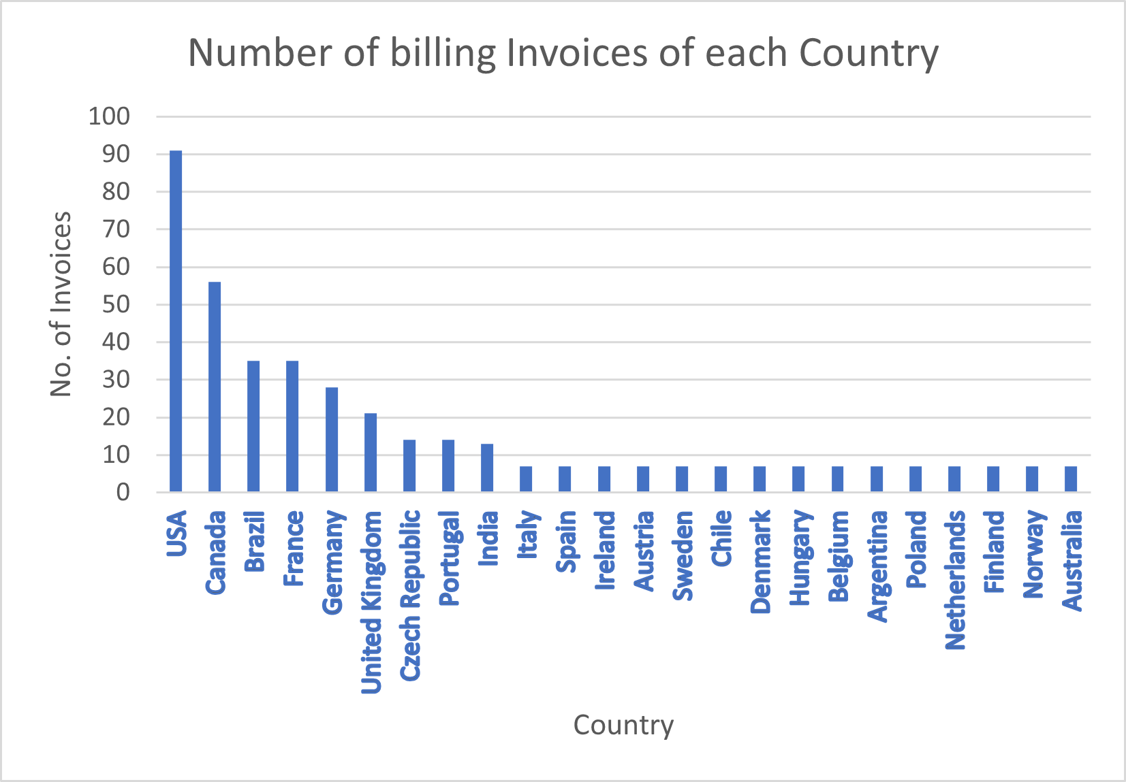
Question 1:
Which countries have the most Invoices?
Query 1:
“Select BillingCountry, count(invoiceid)
from invoice
group by BillingCountry
order by 2 Desc”
This chart describes the number of purchases done by customers in each Country.

Slide 3
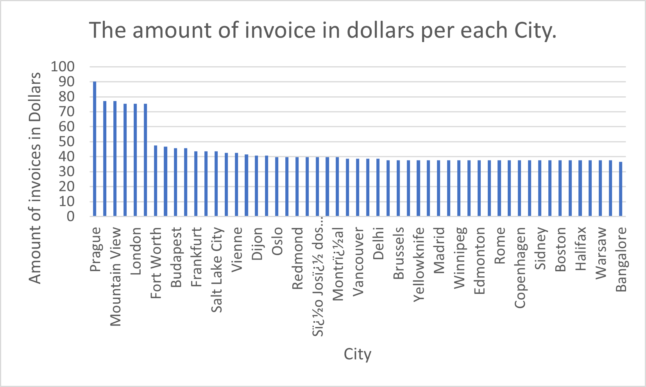
Question 2:
Which city has the best customers?
Query 2:
“Select BillingCity, sum(total)
from invoice
group by BillingCity
order by 2 Desc”
This chart describes the amount earned from each city and it could be used for marketing purposes to determine the best city to host a festival.

Slide 4
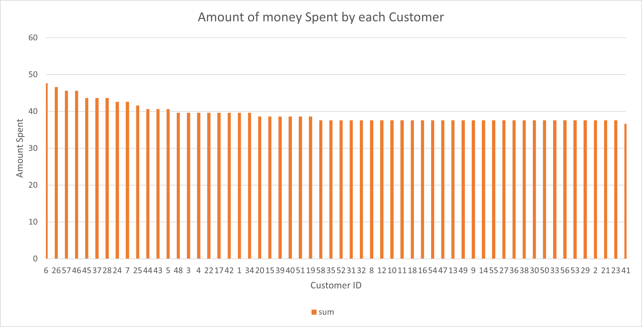
Question 3:
Who is the best customer?
Query 3:
“Select ie.customerid, sum(unitprice)
from invoice as ie
join InvoiceLine as il
on ie.invoiceid = il.invoiceid
join Customer as cr
on ie.customerid = cr.customerid
group by 1
order by 2 desc
limit 1”
This chart describes the amount spent by each Customer by their numeric ID.
This may be used for marketing purposes by giving a gift to the best customers.

Slide 5
Question 4:
What is the email, first name, last name, and Genre of all Rock Music listeners
Query 4:
“Select distinct(cr.email), cr.firstname, cr.lastname, g.name
from invoice as ie
join InvoiceLine as il
on ie.invoiceid = il.invoiceid
join Customer as cr
on ie.customerid = cr.customerid
join track as t
on t.trackid = il.trackid
join genre as g
on g.genreid = t.genreid
where g.name = 'Rock'
order by 2”

Slide 6
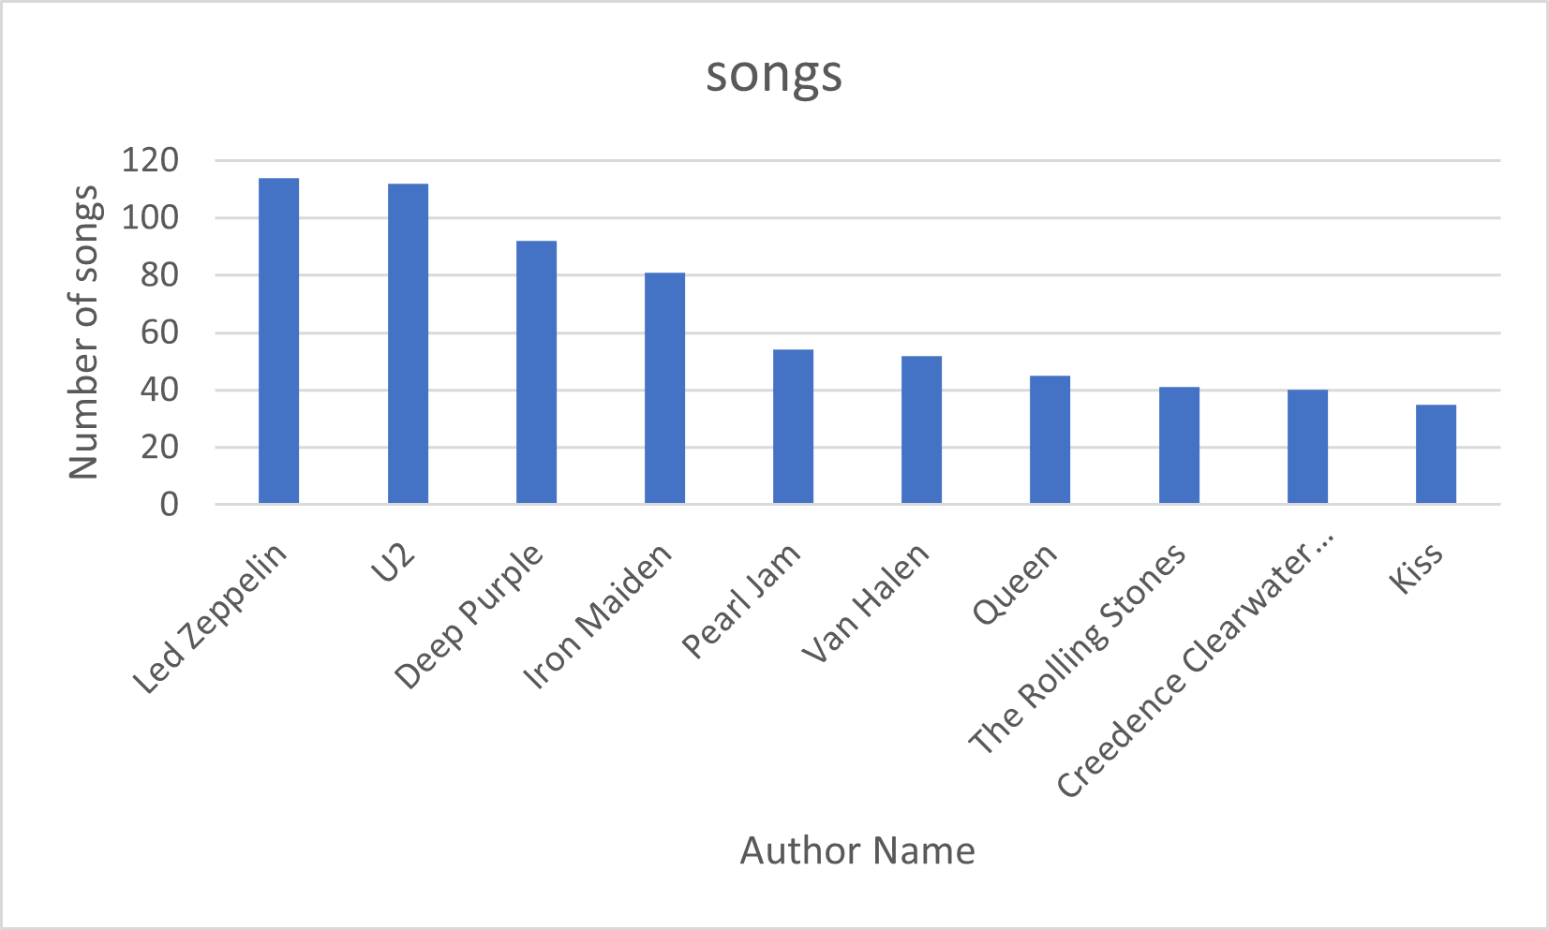
Question 5:
Who is writing the rock music?
Query 5:
“select ROW_NUMBER() OVER (order by count(g.name) desc) as " ", a.artistid, at.name, count(g.name) as Songs
from Genre as g
join track as t
on g.genreid = t.genreid
join album as a
on t.albumid = a.albumid
join artist as at
on a.artistid = at.artistid
where g.name = 'Rock'
group by at.name, a.artistid
order by count(g.name) desc
limit 10”
This chart shows the number of songs produced by each author by which it could be used for marketing purposes.

Slide 7
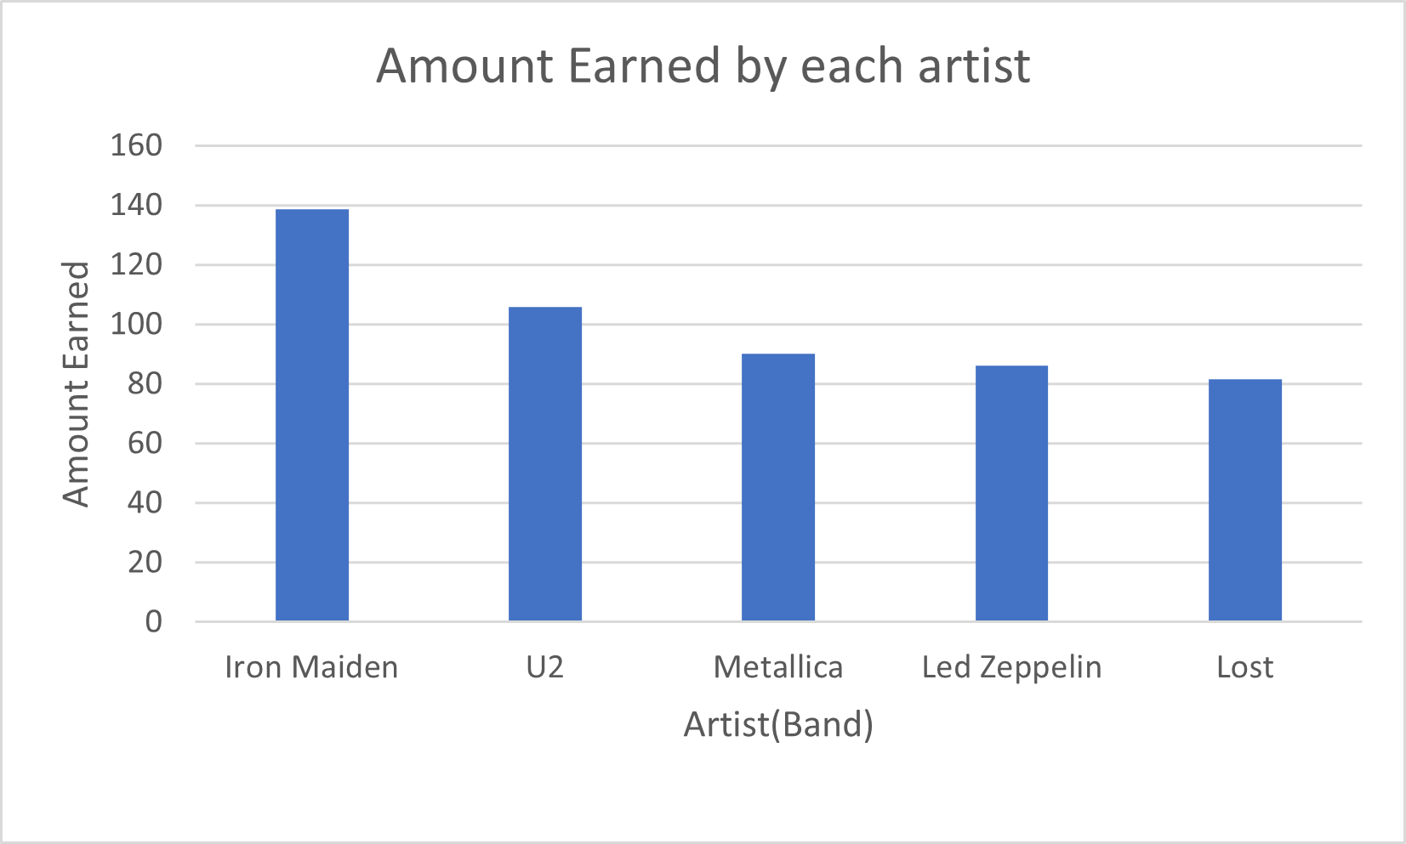
Question 6:
Which artist has earned the most ?
Query 6:
“select ROW_NUMBER() OVER (order by sum(il.unitprice) desc) as " ", at.name, sum(il.unitprice) as "amount spent"
from customer as cr
join invoice as iv
on cr.customerid = iv.customerid
join invoiceline as il
on iv.invoiceid = il.invoiceid
join track as tr
on il.trackid = tr.trackid
join album as a
on tr.albumid = a.albumid
join artist as at
on a.artistid = at.artistid
group by at.name
order by 3 desc
limit 5”
This chart describes the amount earned by each artist in their concerts which maybe used to determine which artist has the most fans.

Slide 8
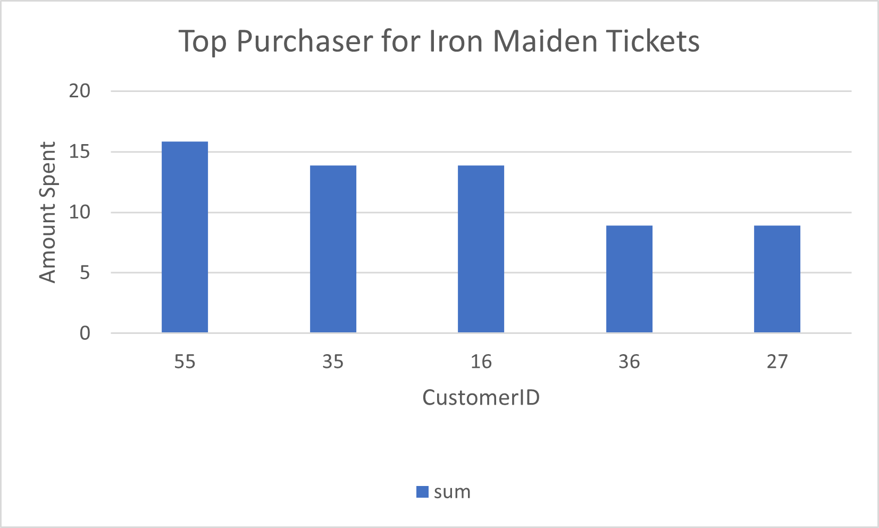
Question 7:
Who are the top purchasers of Iron Maiden concert tickets?
Query 7:
“select sub.*
From (
select at.name, sum(il.unitprice), iv.customerid, cr.firstname, cr.lastname
from customer as cr
join invoice as iv
on cr.customerid = iv.customerid
join invoiceline as il
on iv.invoiceid = il.invoiceid
join track as tr
on il.trackid = tr.trackid
join album as a
on tr.albumid = a.albumid
join artist as at
on a.artistid = at.artistid
group by at.name, iv.customerid, cr.firstname, cr.lastname
order by sum(il.unitprice) desc, at.name
limit 20 ) sub
where name = 'Iron Maiden' ”
This chart describes the top fans for Iron Maiden, and it could be used for marketing purposes by giving them a discount to encourage other fans to attend more concerts.

